Slide 1

Library Management System
(Phase 2)
សាកលវិទ្យាល័យភូមិន្ទភ្នំពេញ
ROYAL UNIVERSITY OF PHNOM PENH
Software Engineering
Professor: Lim Lyheng
Class: M1
Group: 8

Slide 2

Group Member
Name | Name in khmer | Role
Sou Chanrojame | ស៊ូ ចាន់រ៉ូជែម | Leader
Orn Pheakdey | អន ភក្ដី | Follower
Long Neron | ឡុង និរន្ដ | Follower
Sokkong Somnang | សុខគង់ សំណាង | Follower

Slide 3
Table of Contents
1
DFD 0 (Context Diagram)
6
ERD
2
DFD 1
7
UI/UX Design
3
DFD 2
8
Program Design
4
Use Case Diagram
9
Report Design
5
10
Sponsor
Deployment Diagram

Slide 4
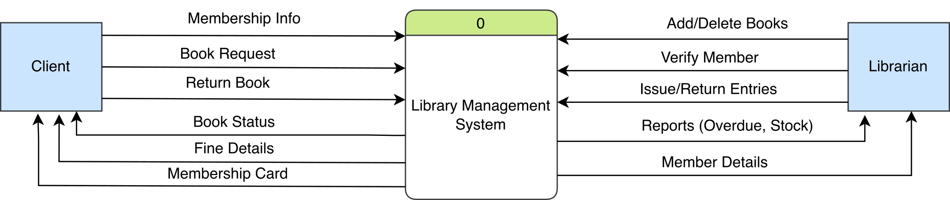
DFD 0 (Context Diagram)
We use Gane-Sarson notation for Data Flow Diagram.

Slide 5
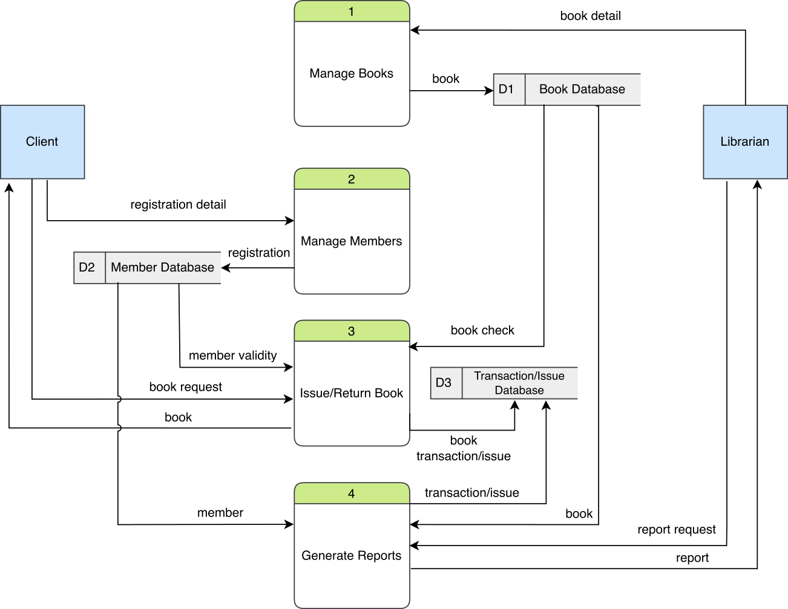
DFD 1

Slide 8
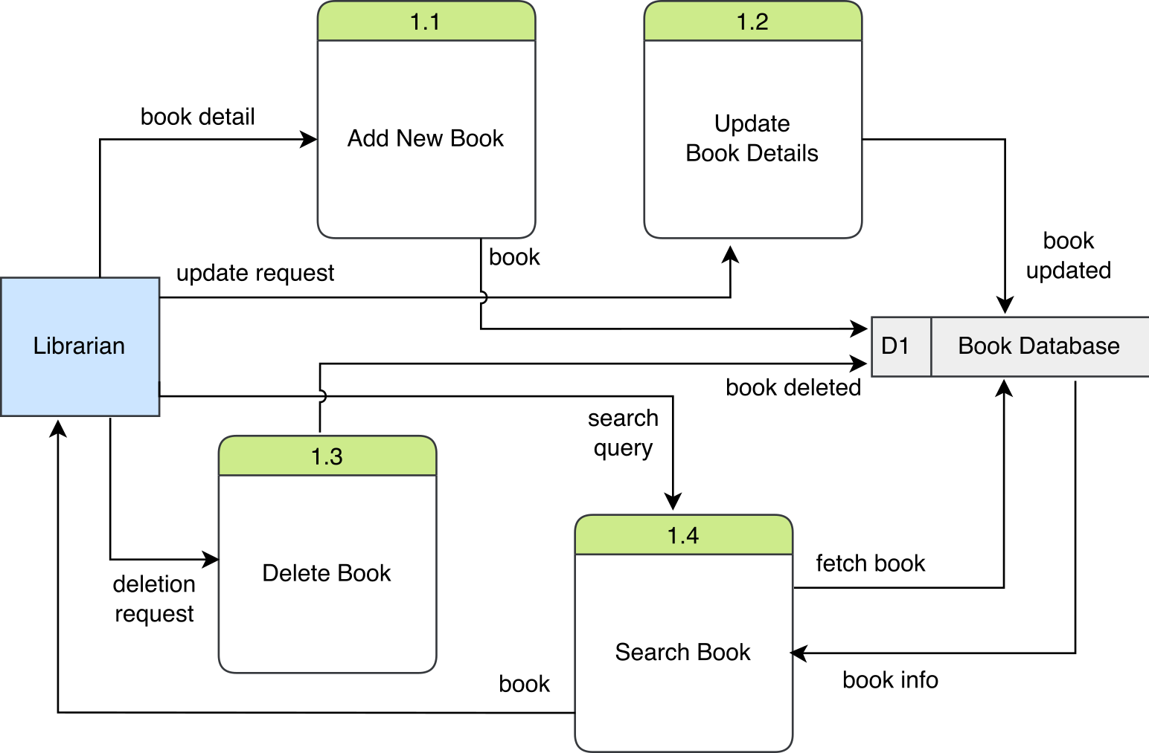
DFD 2

Slide 9
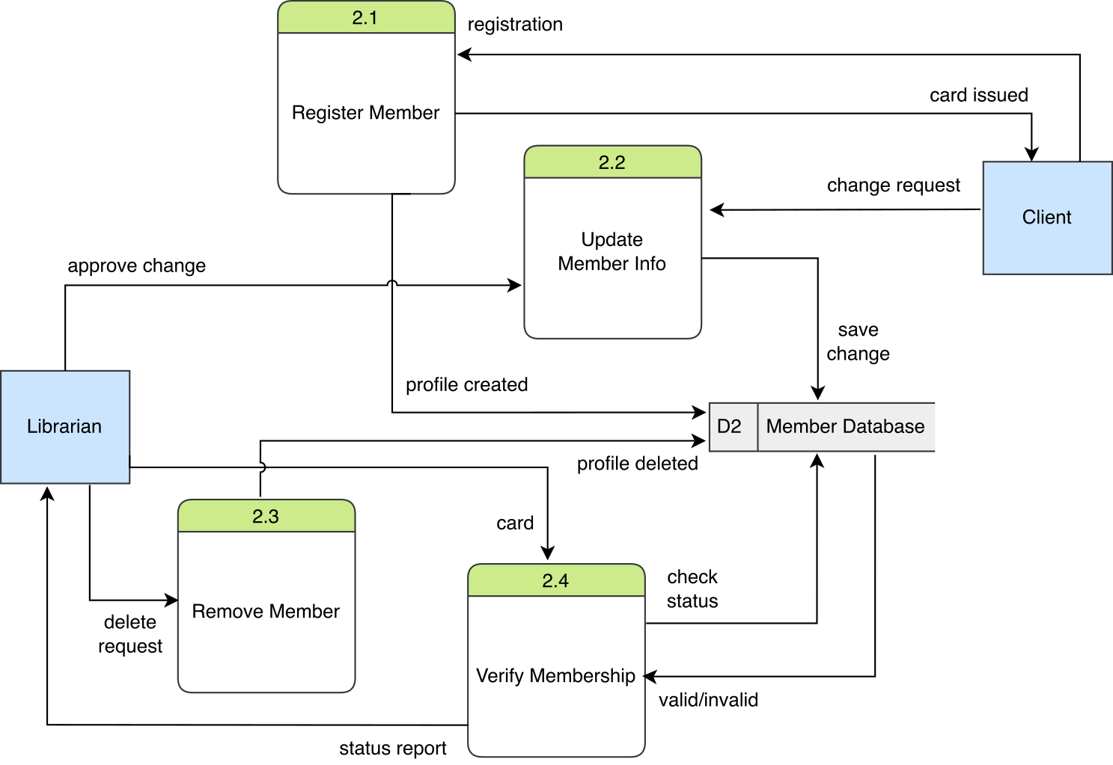

Slide 11
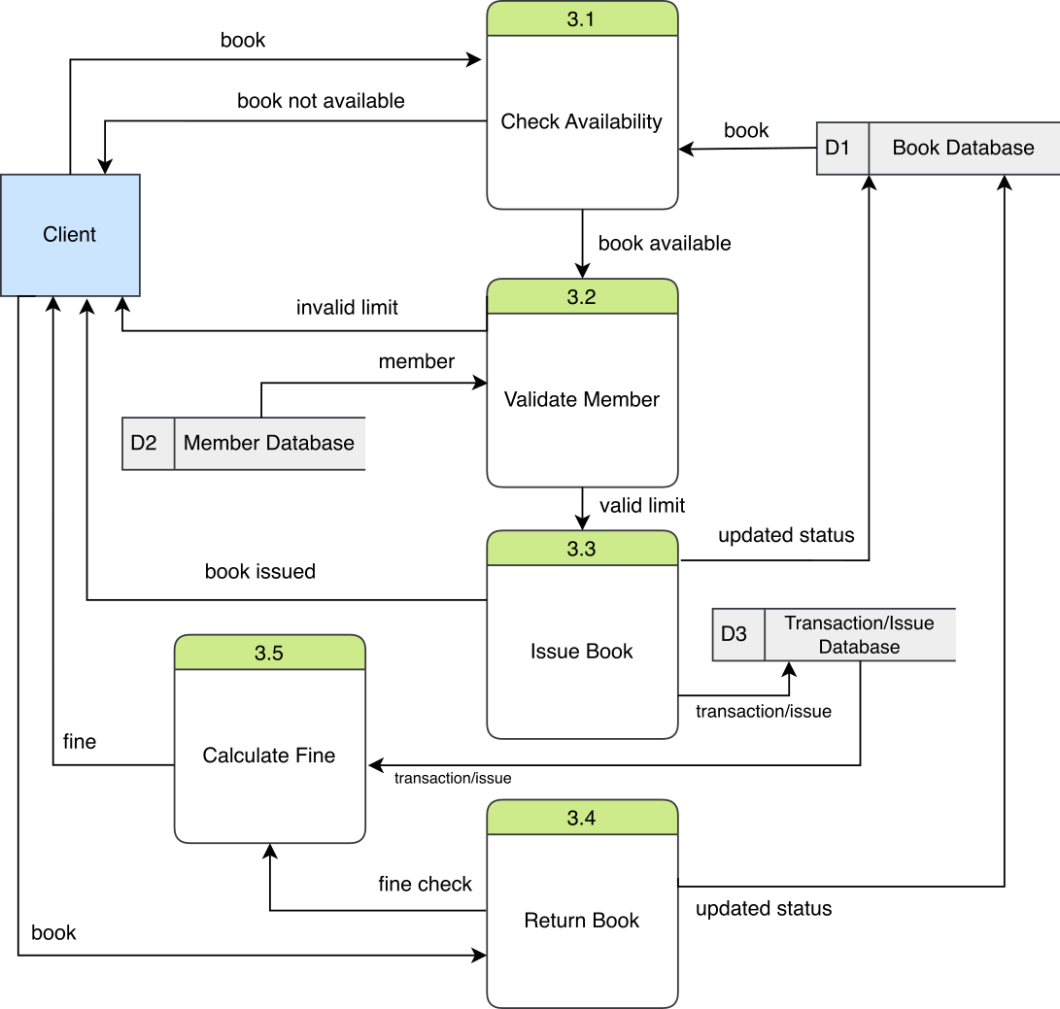

Slide 13
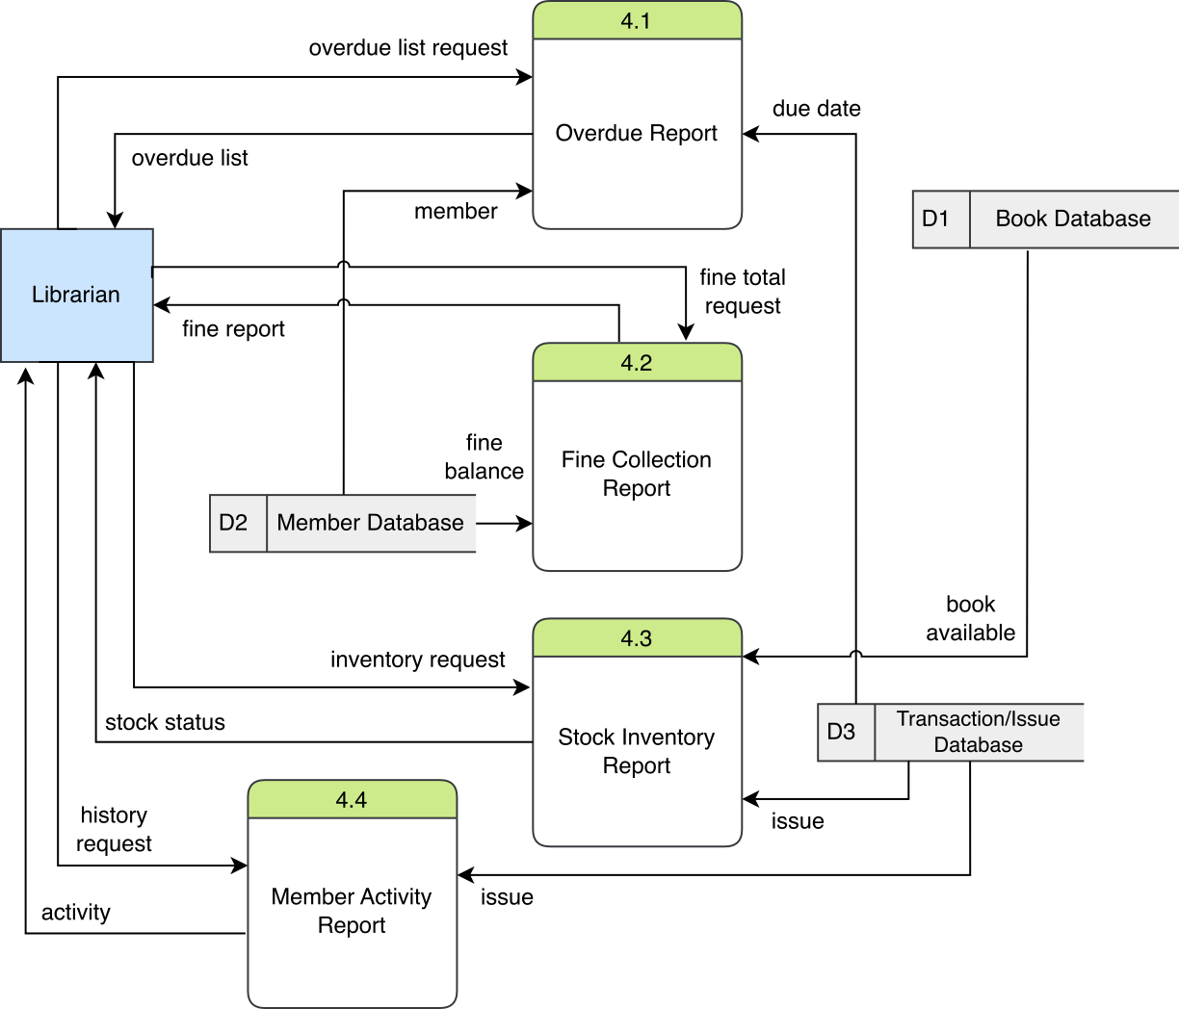

Slide 15
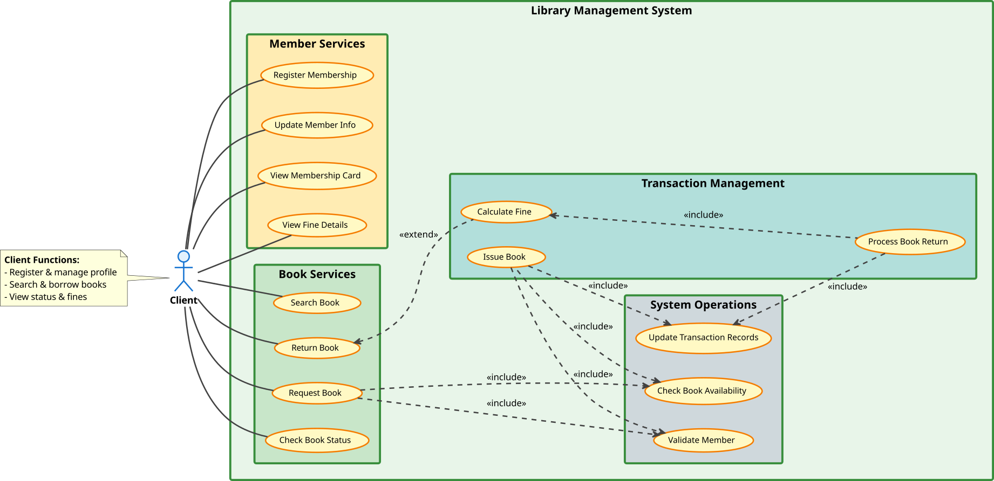
Use Case Diagram

Slide 18
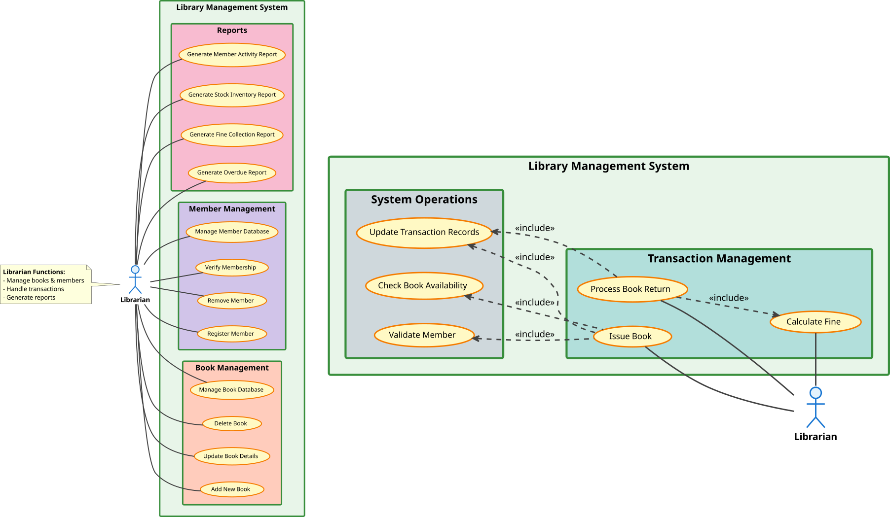

Slide 22
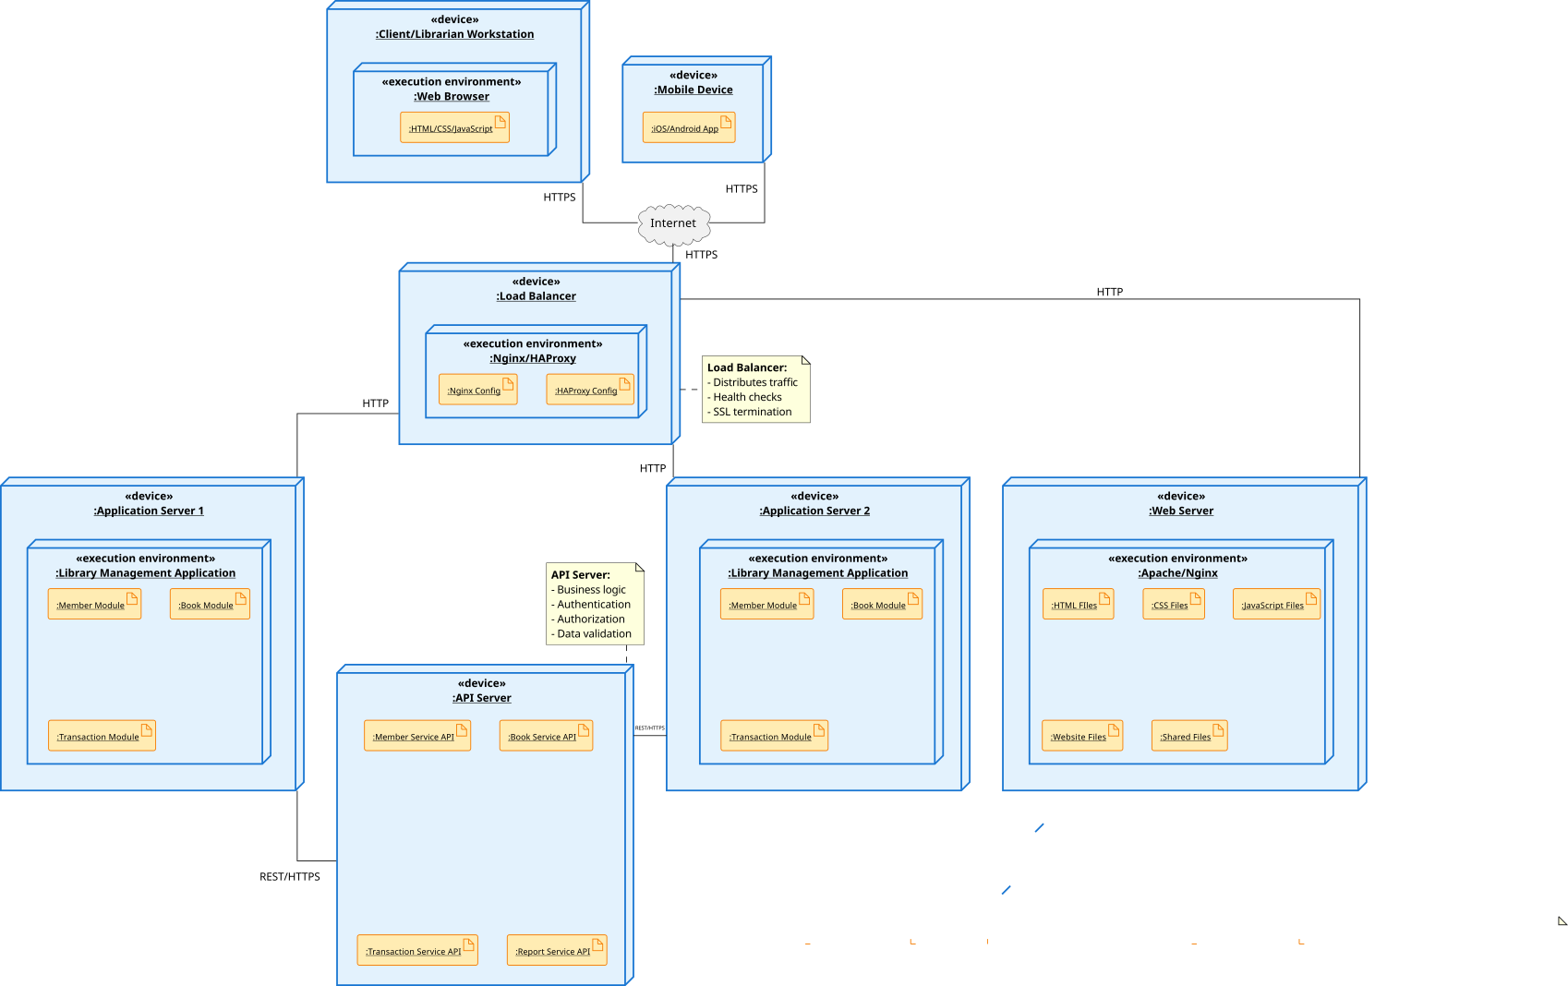
Deployment Diagram

Slide 25
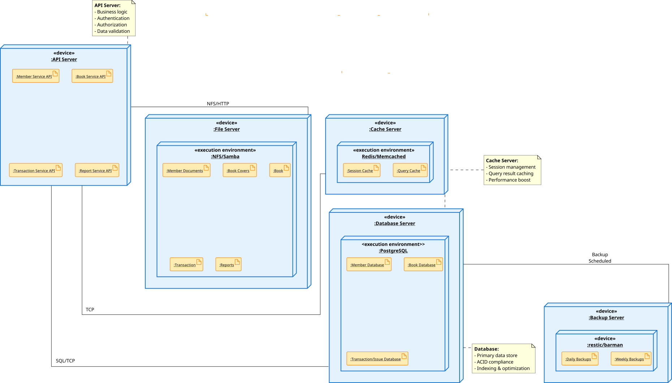

Slide 28
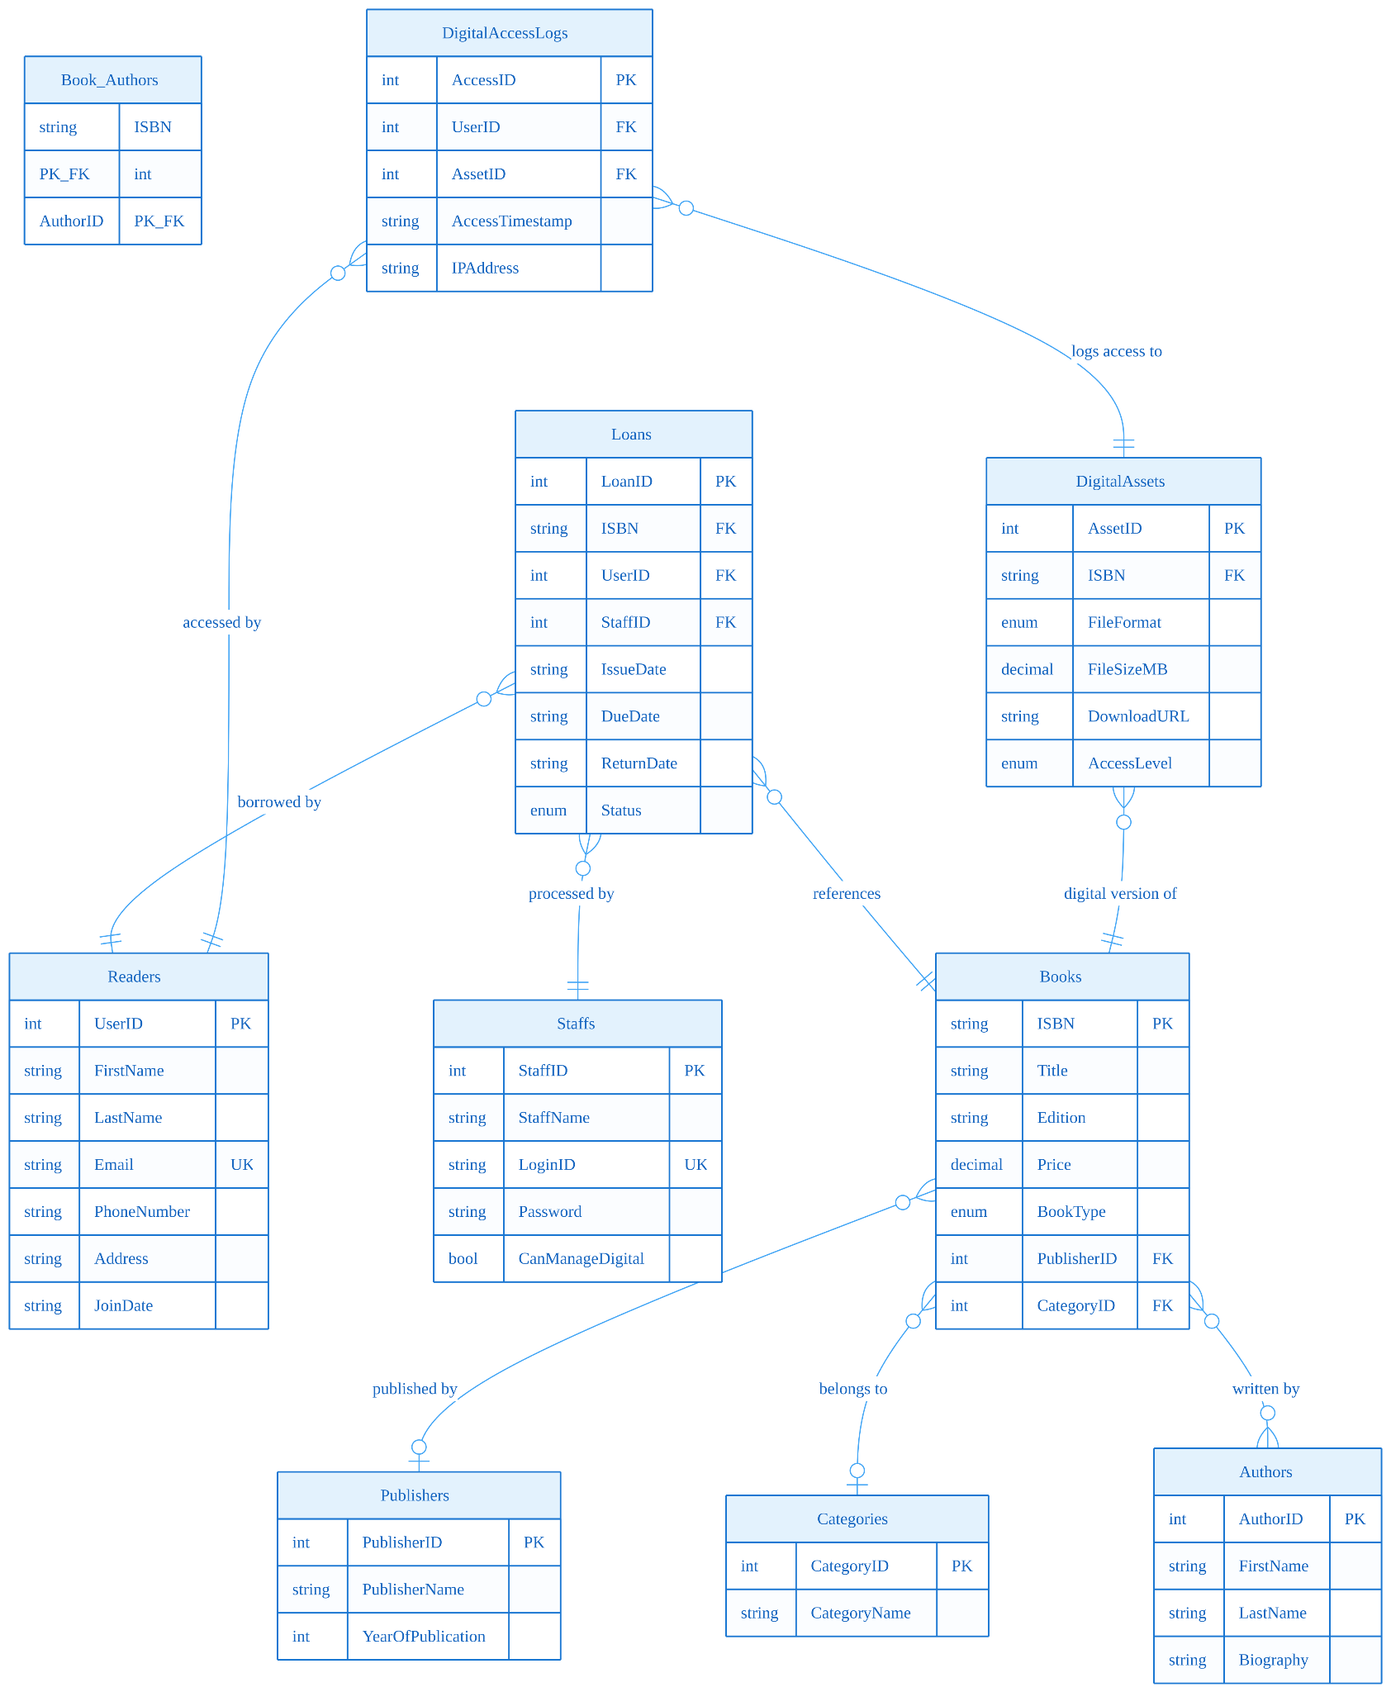
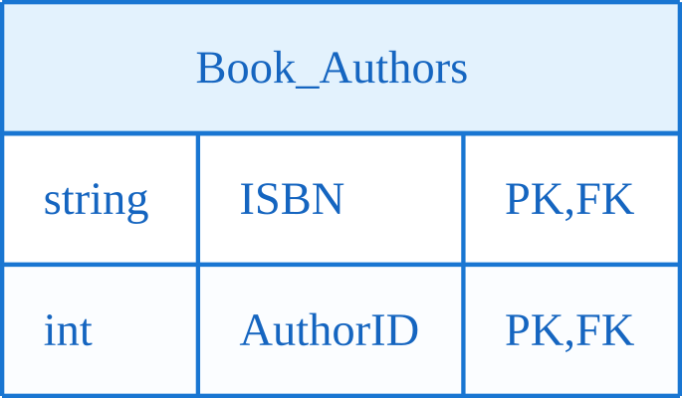
ERD (Entity Relationship Diagram)
We use Crow’s Foot Notation for ERD.

Slide 34
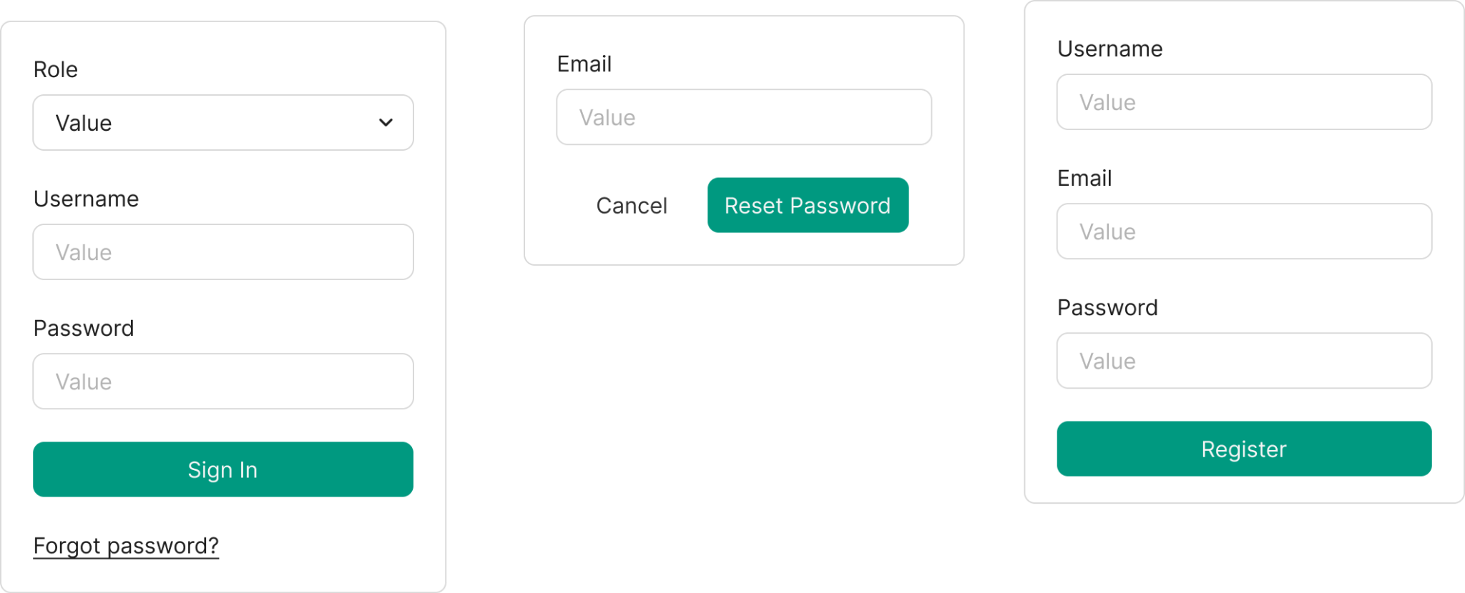
UI/UX Design

Slide 35
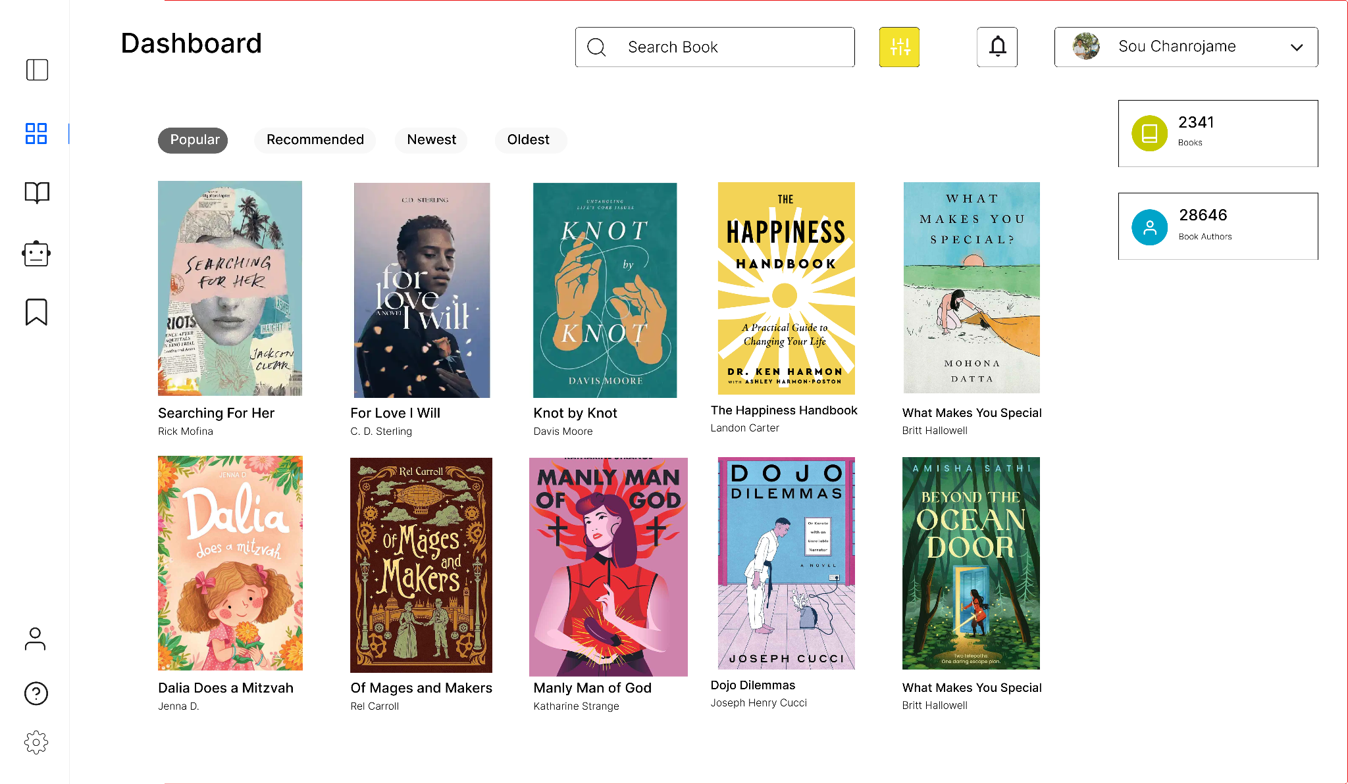

Slide 36
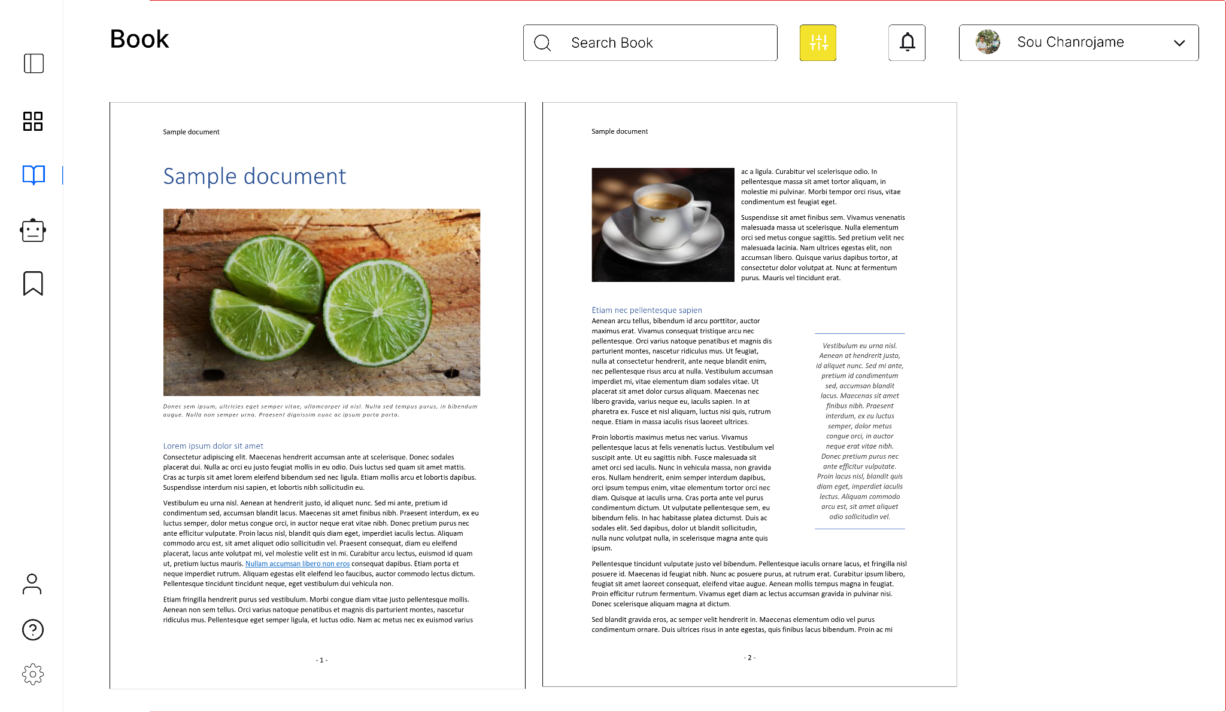

Slide 37
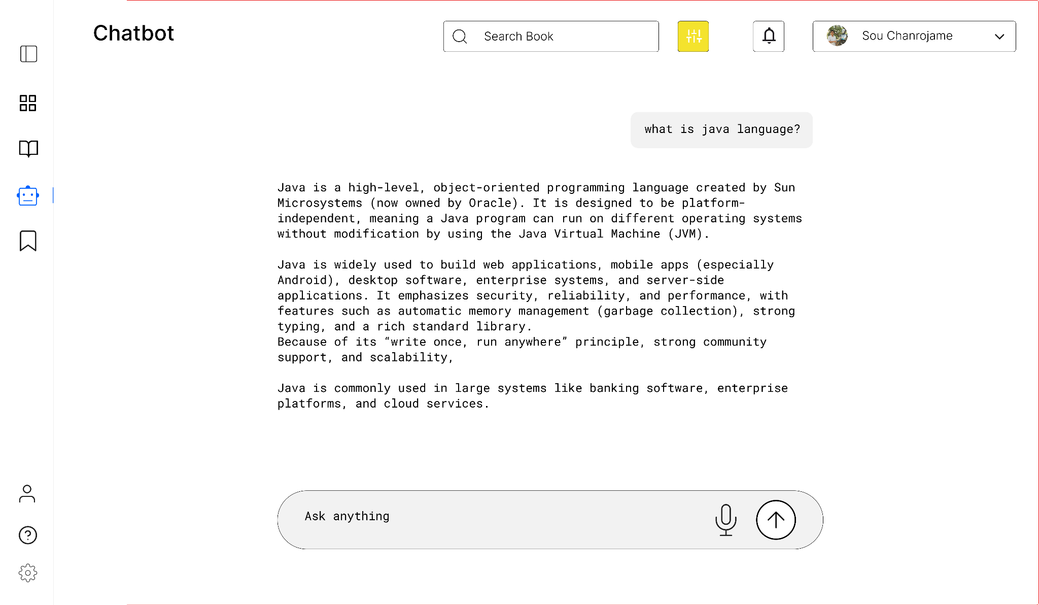

Slide 38
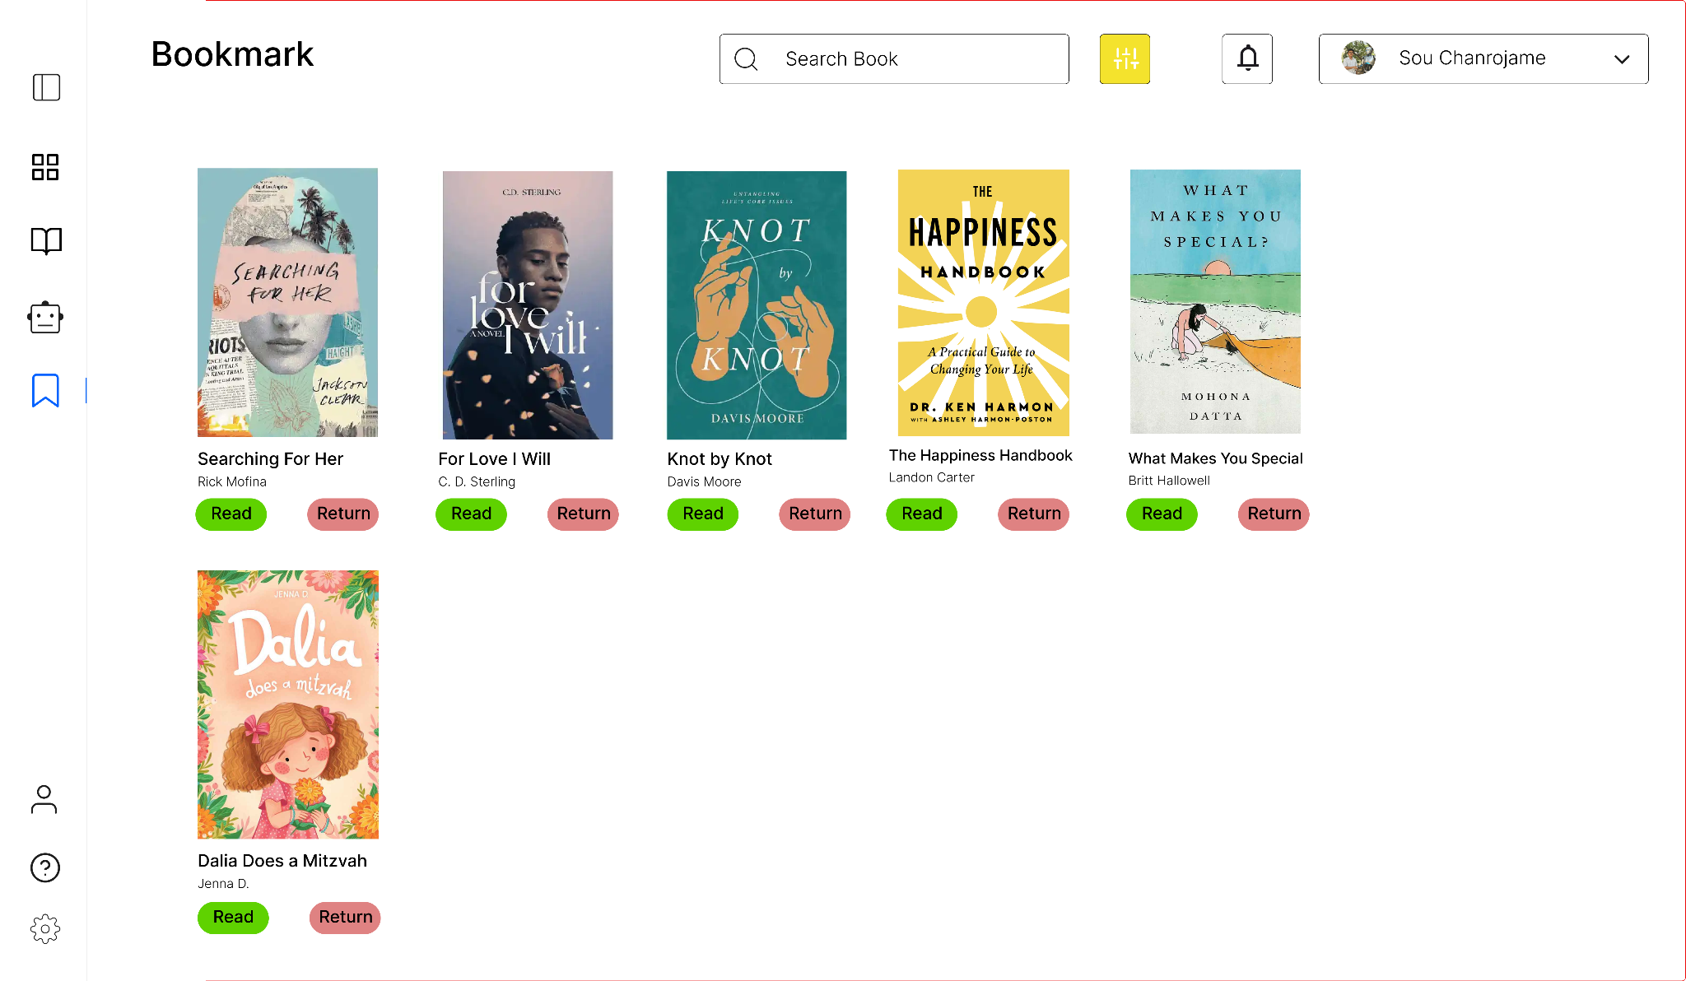

Slide 39
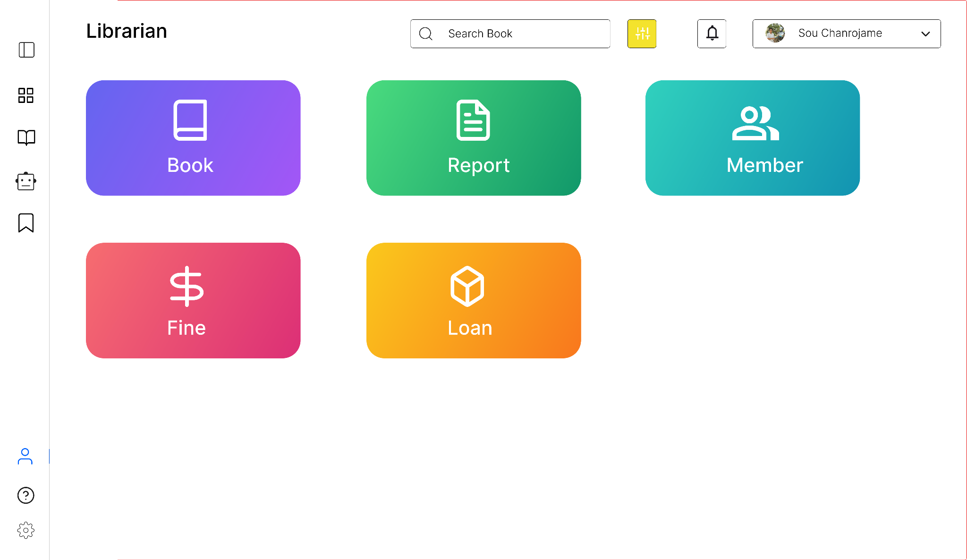

Slide 40
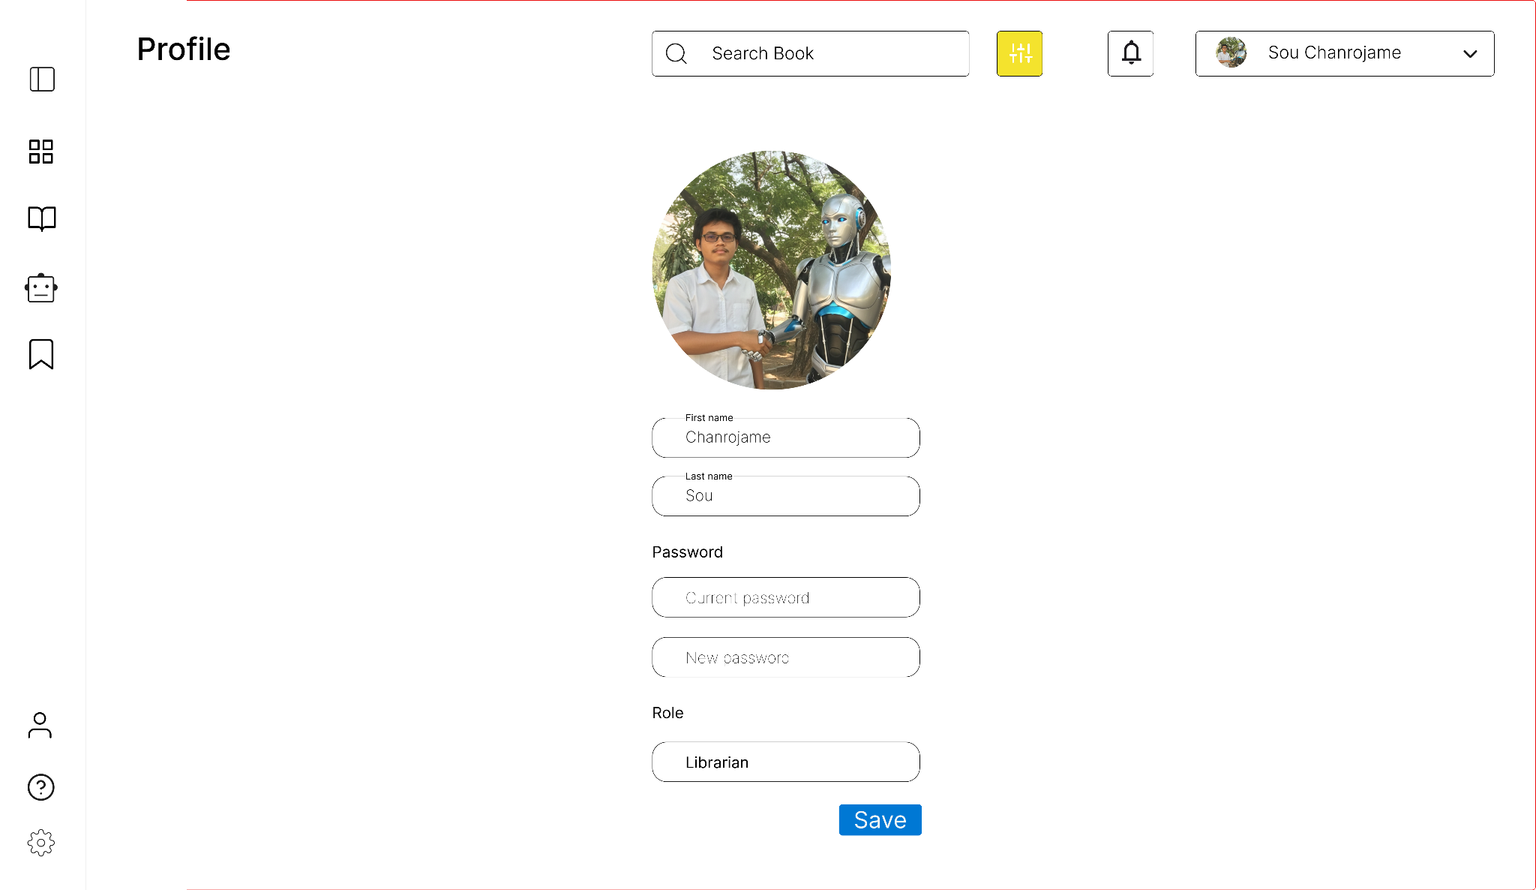

Slide 41
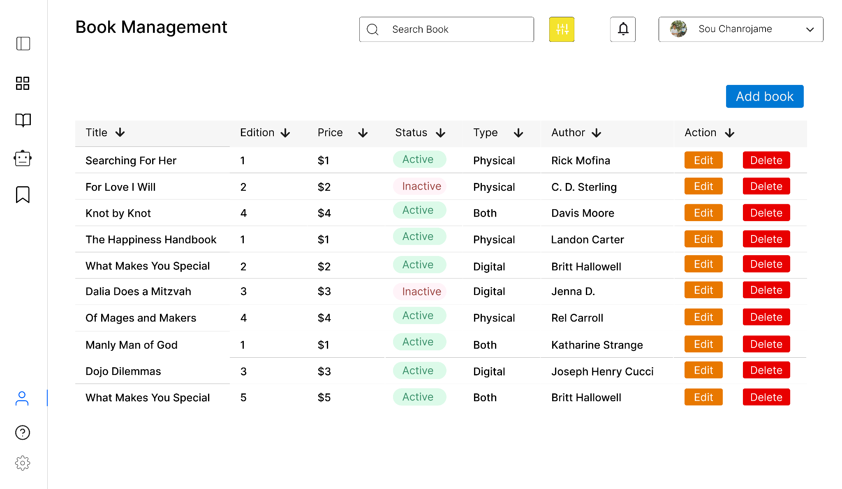

Slide 42
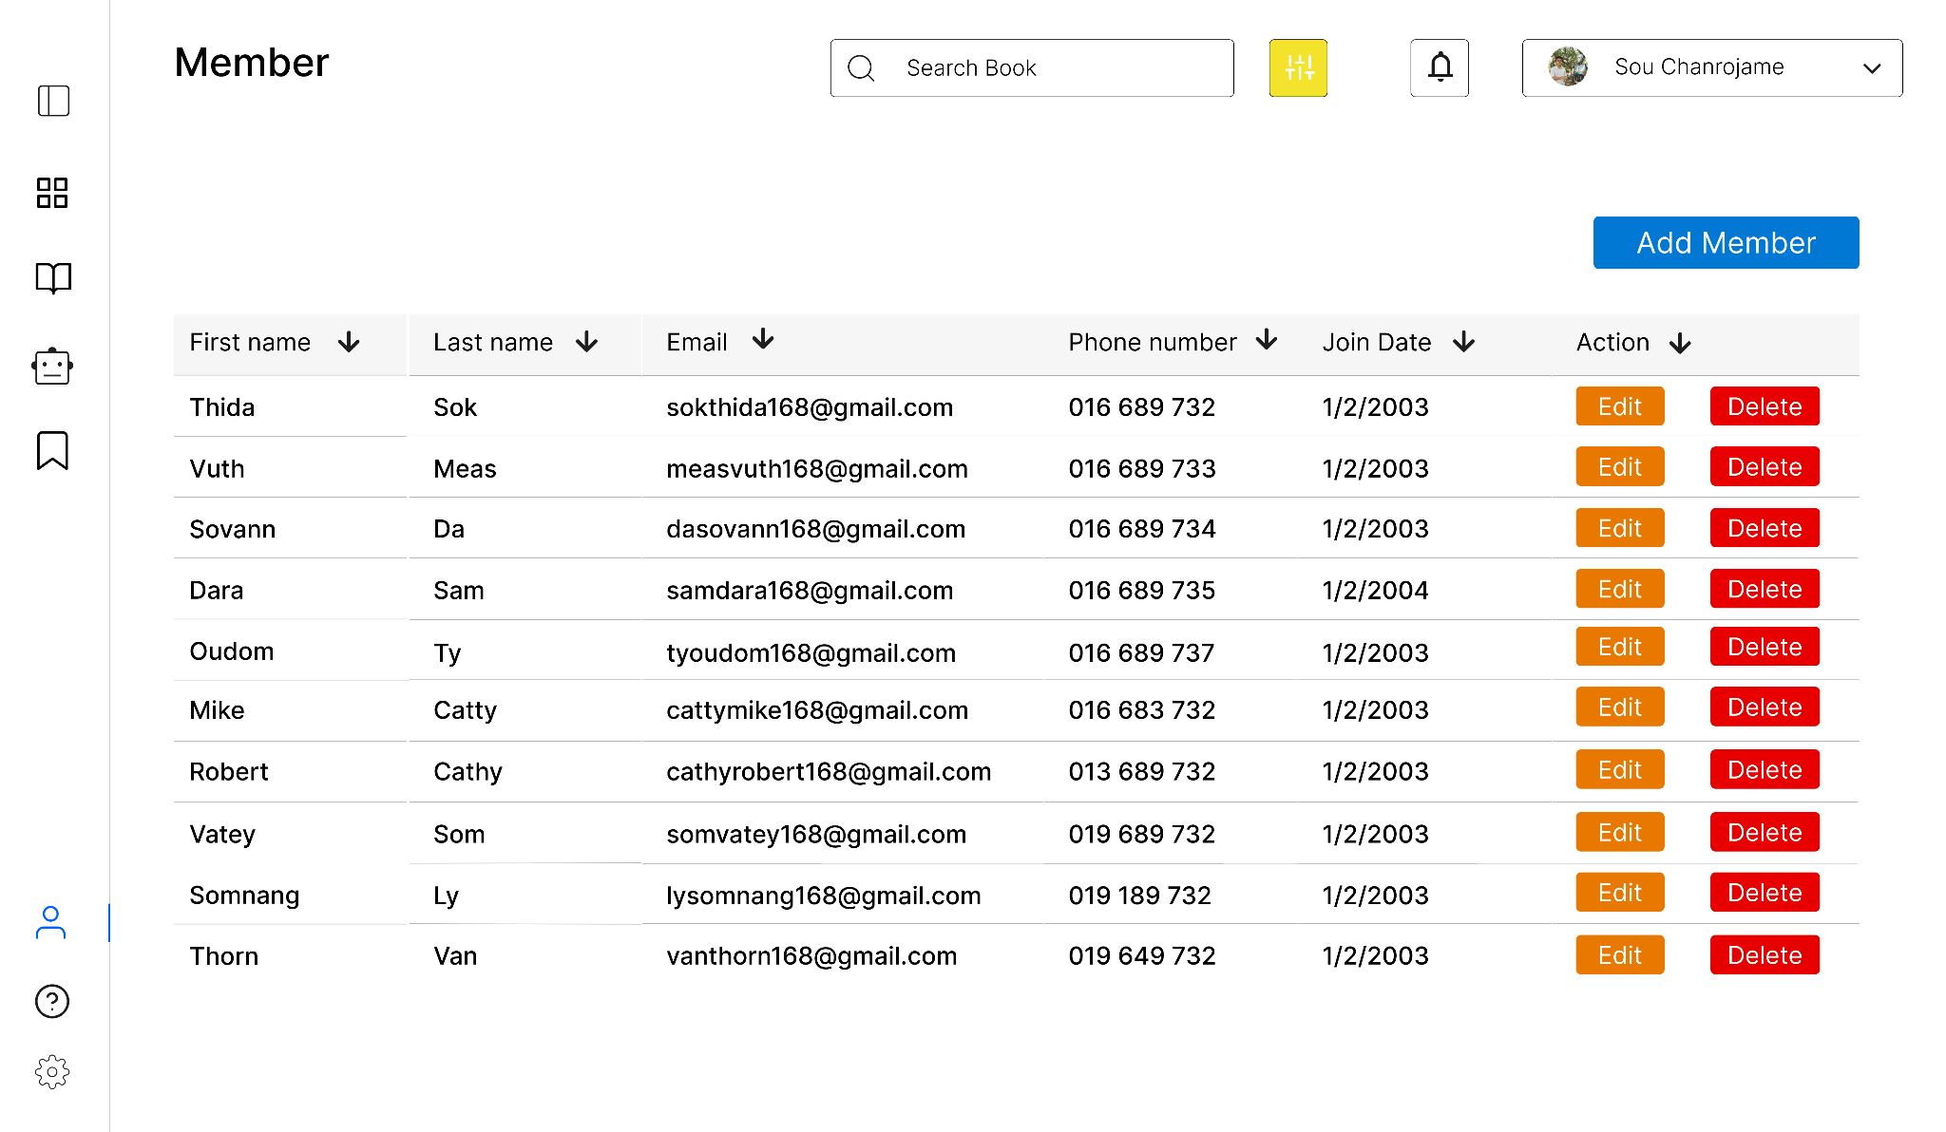

Slide 43
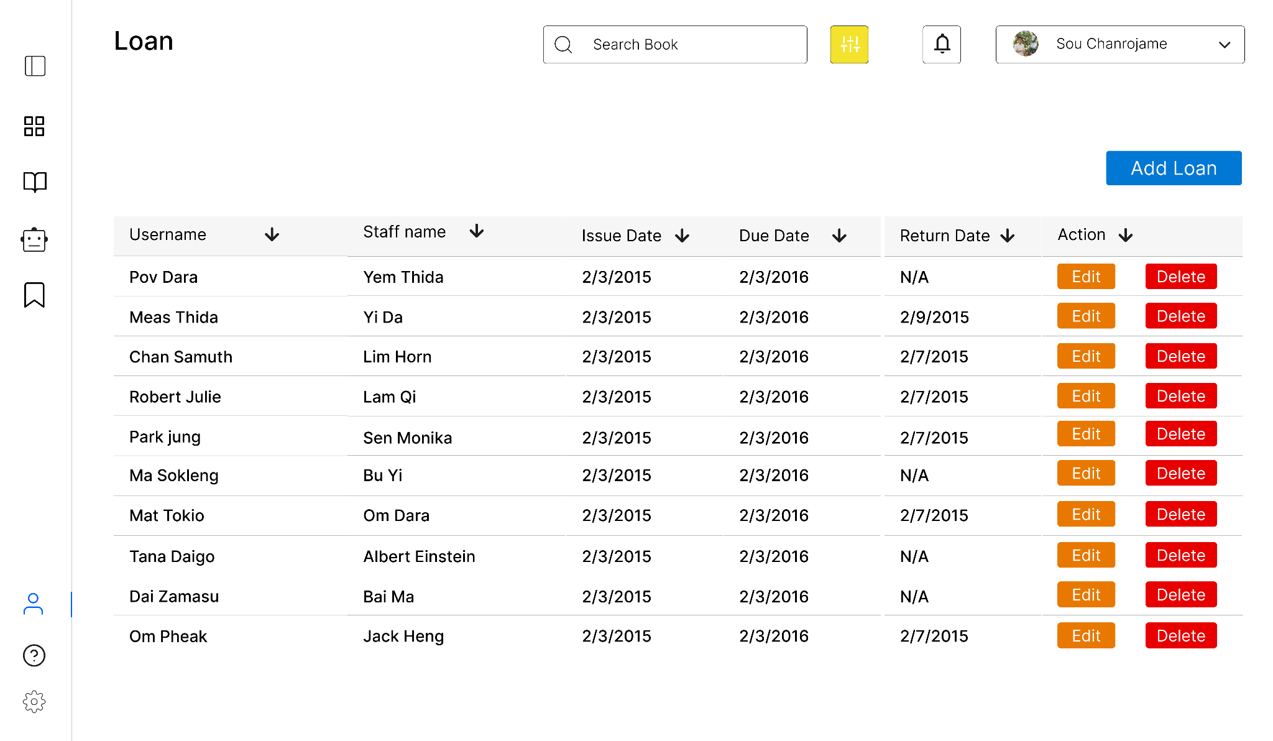

Slide 44
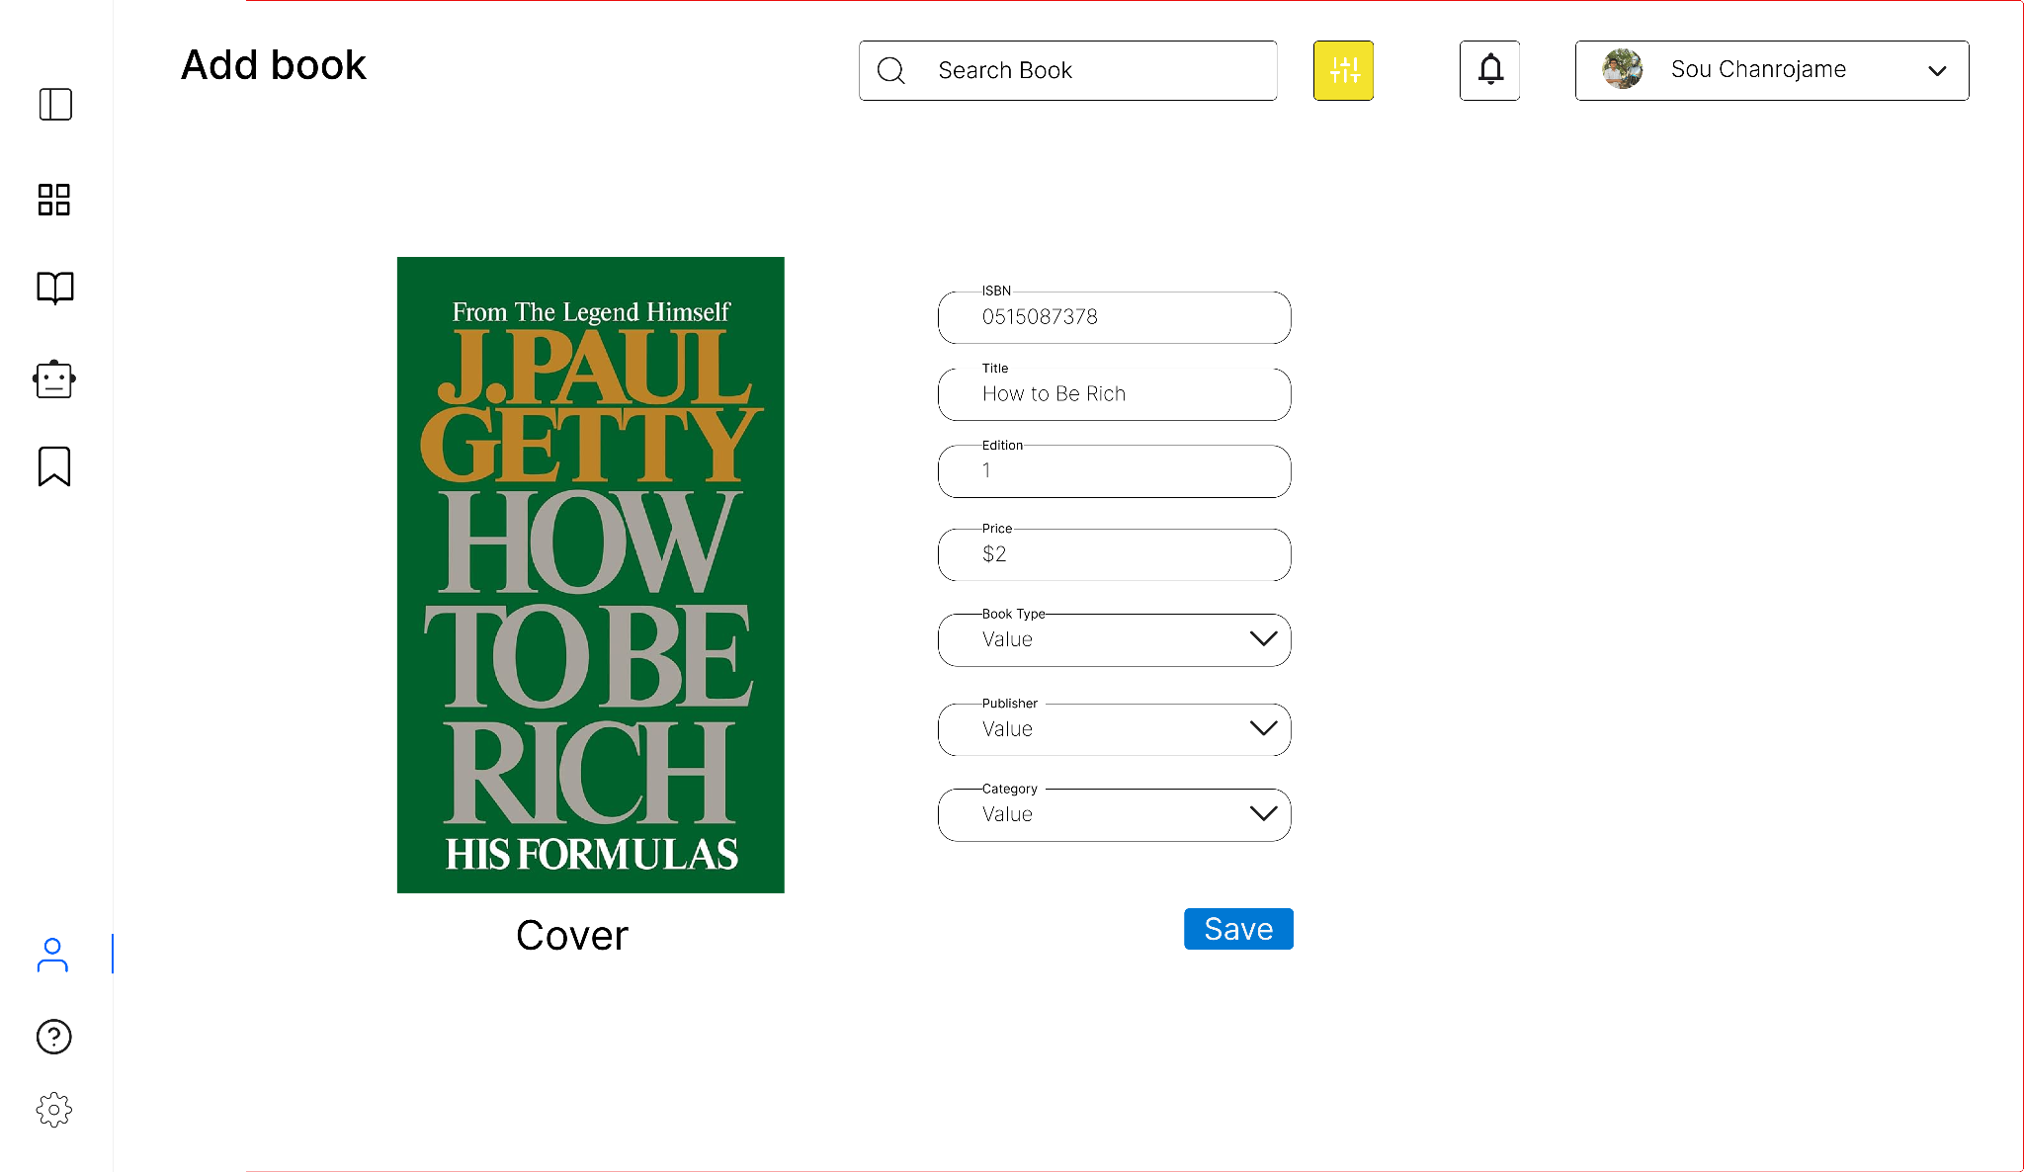

Slide 45
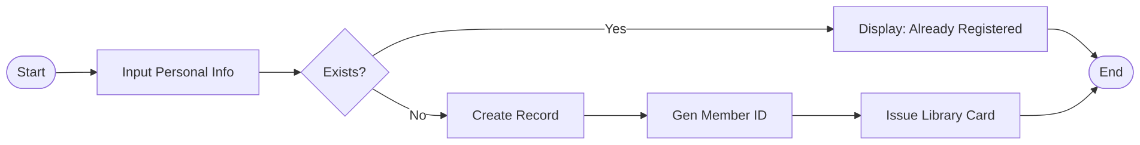
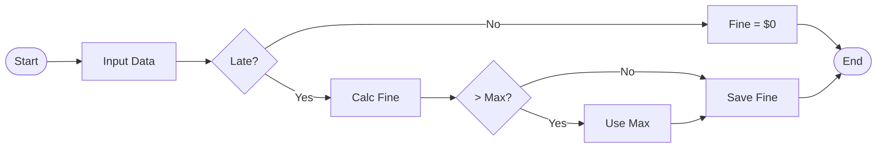
Program Design
We have flowcharts, pseudocode, and test data before coding.
Flowchart for member registering
Flowchart for calculating fine

Slide 46
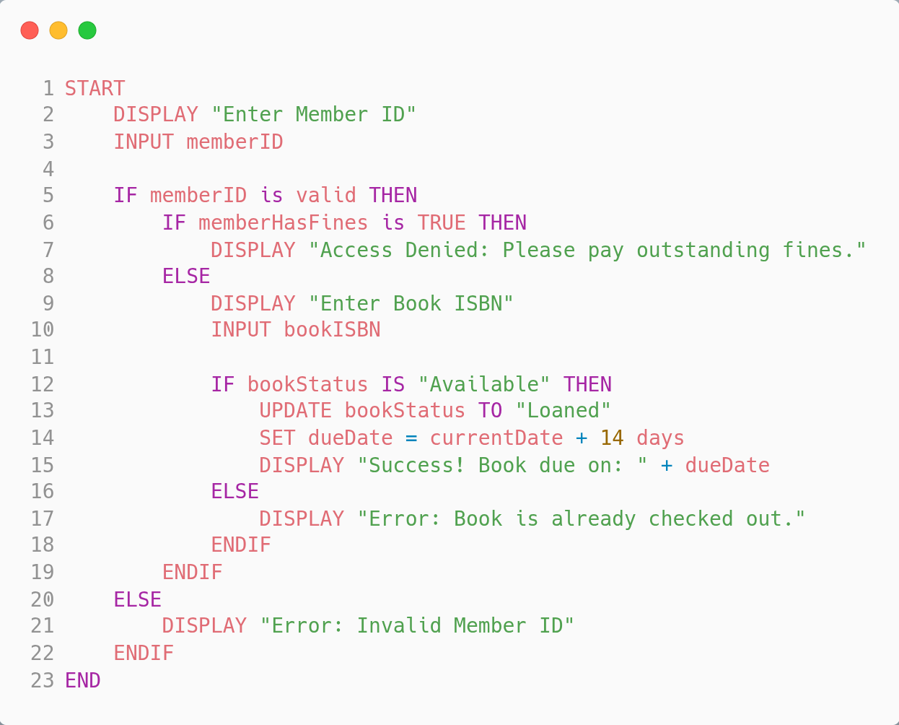
Pseudocode for borrowing a book

Slide 47
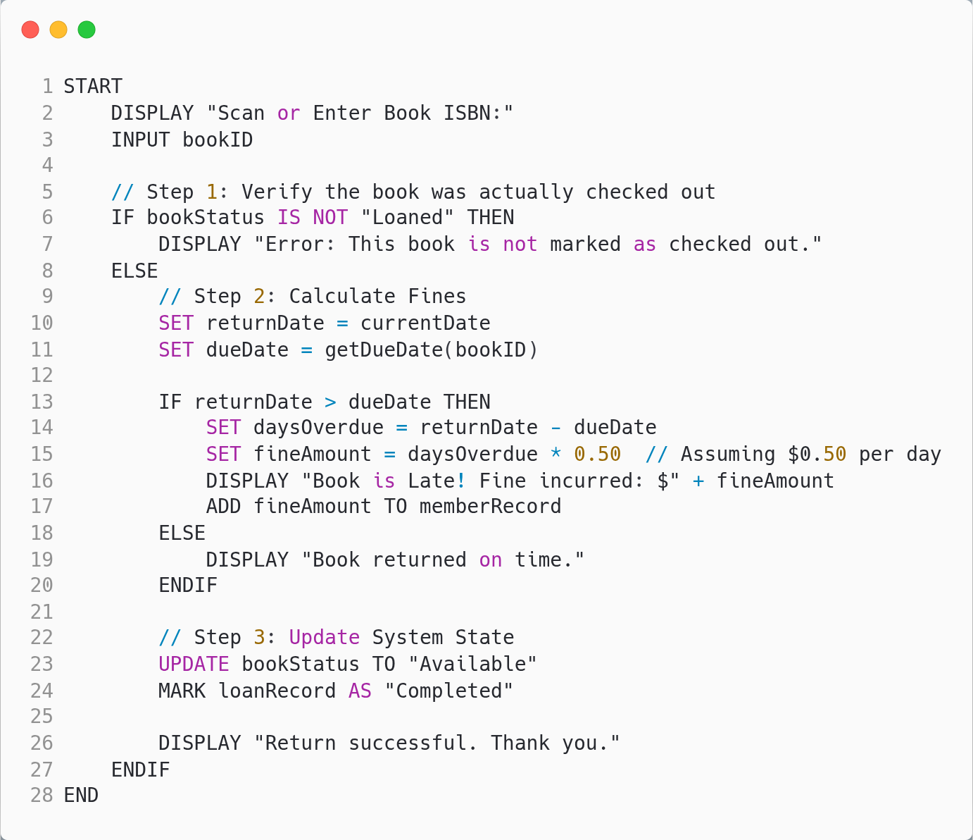
Pseudocode for returning a book

Slide 48
Test Case | Member ID | Book Status | Has Fines? | Expected Result
Normal | M101 (Valid) | Available | No | Success, Status -> Loaned
Fine Block | M102 (Valid) | Available | Yes | Error: "Please pay fines"
Unavailable | M101 (Valid) | Loaned | No | Error: "Book already checked out"
Invalid User | X999 (Invalid) | Available | No | Error: "Invalid Member ID"
Test data for
borrowing a book
Input | Processing | Output
Book ISBN / ID | Find the active loan record | Return Confirmation
Return Date | Calculate days between Due Date and Return Date | Fine Amount (if applicable)
Member ID | Update Book status to "Available" | Updated Member Account
Test data for
returning a book
Test Case | ID Number | Database Status | Expected Result
New User | 12345 | Not Found | Record Created, New ID Issued
Existing User | 12345 | Already Found | Error: "Already Registered"
Missing Info | (Empty) | N/A | Error: "Fields cannot be blank"
Test data for
member registration

Slide 49
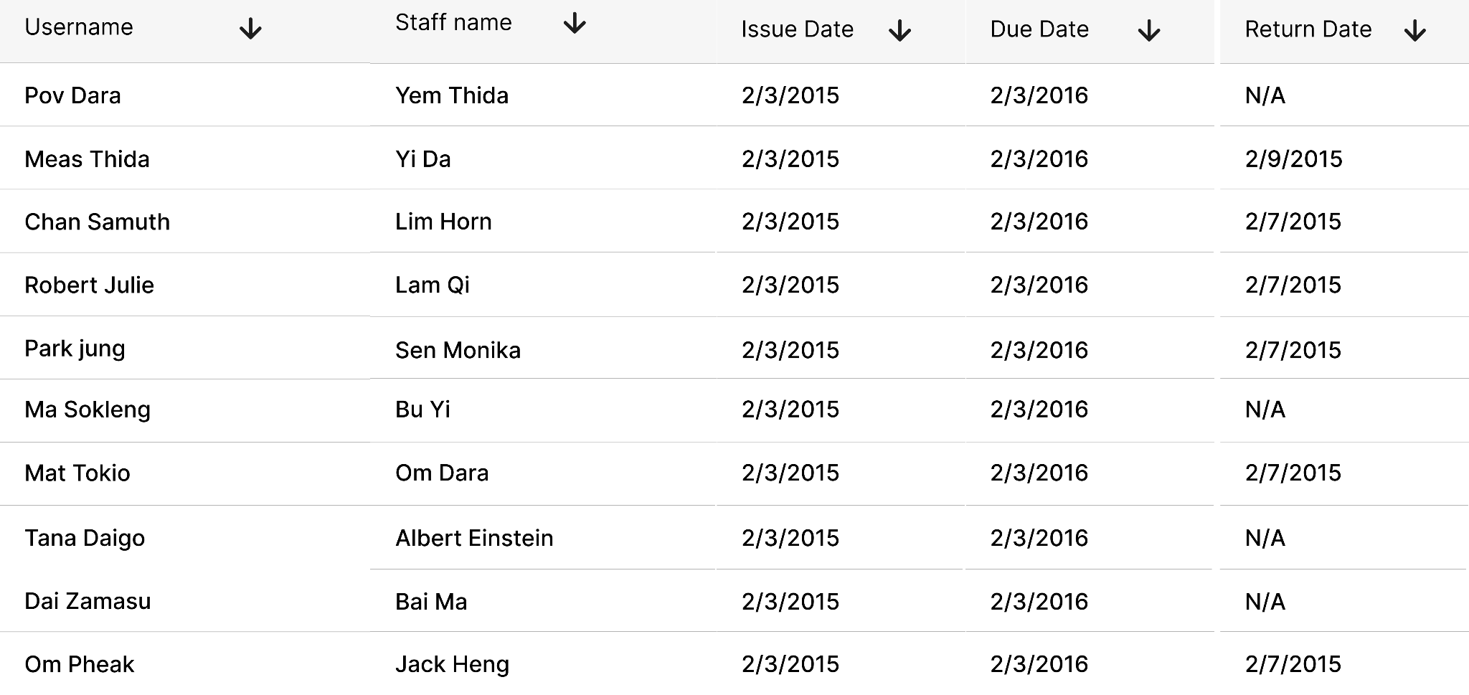
Report Design
Report on loans

Slide 50
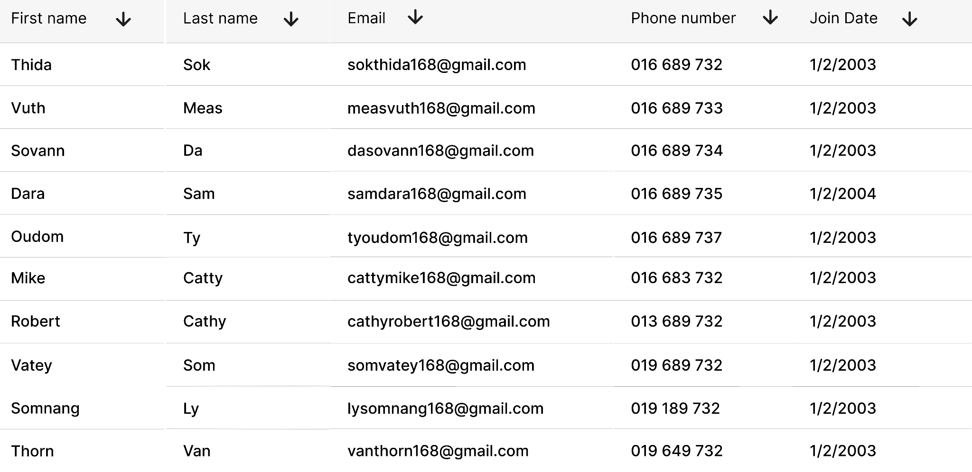
Report on members

Slide 51
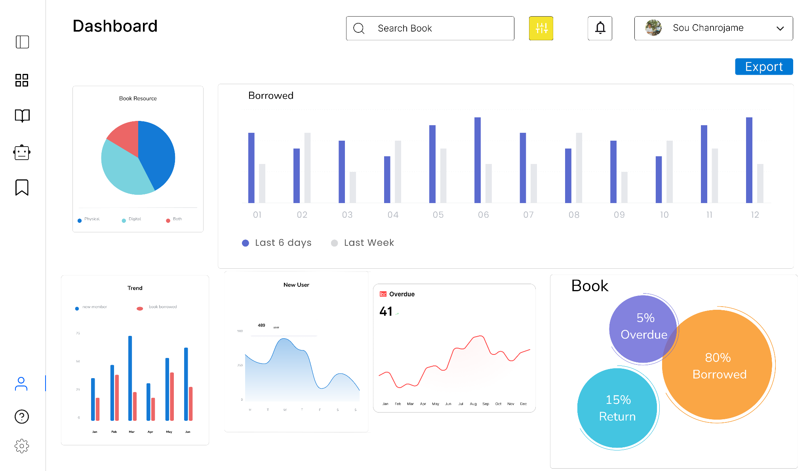

Slide 52

Sponsor
We rent a machine to host our application in cloud.
Thanks to Sokkong Somnang for sponsoring $3
Thanks to Long Neron for sponsoring $2

Slide 53


